Slide 1
Predicting Air Quality index DATS6450 time series analysis– Final Term Project professor : Reza Jafari
Presented by:
Pranay Bhakthula

Slide 2
Today’s Discussion
Introduction
Description of Dataset
Stationarity
Time Series Decomposition
Holt-Winters method
Feature Selection
Base-Models
Multi-Linear Regression
ARMA and ARIMA model
Diagnostic Analysis
Final Model selection
Forecast function
h-step ahead Predictions
Summary and conclusion
Appendix
References

Slide 3
Introduction
The focus of this project is to find the best time series model and predict the Air quality Index of ‘Delhi’ using various time series modelling methods. As the Air Quality Index (AQI) increases, it suggests that the pollution of the city is increasing. It is important for the Government to know the predictions of AQI and try to make policies so as to reduce the pollution of the city. In cities like ‘Delhi’, air pollution is a major concern and forecasts are required to warn residents to stay in homes, to reduce vehicle traffic and avoid the highways in order to curtail the accidents that happen due to smog/ fog in the months December - January.

Slide 4
Description of Dataset
The dataset contains 707,875 observations which contains hourly data of Air quality Index and other pollutants for 26 cities in India in the period 2015-2020.
Out of these cities we have selected observations of ‘Delhi’ which has 48,192 observations. We are going to analyze and do the modelling on the Air Quality Index of Delhi.
The columns of this dataset are:
'City', 'Datetime', 'PM2.5', 'PM10', 'NO', 'NO2', 'NOx', 'NH3', 'CO', 'SO2', 'O3', 'Benzene', 'Toluene', 'Xylene', 'AQI', 'AQI_Bucket’.

Slide 5
Pre-processing
The target variable is ‘AQI’ which refers to the Air Quality Index.
Since the missing values of ‘Xylene’ are too many, we have dropped that column.
For the rest of the numeric variables we have filled the missing values with the mean of respective columns.
For the categorical variables we have filled the missing values with the mode of the column.

Slide 6
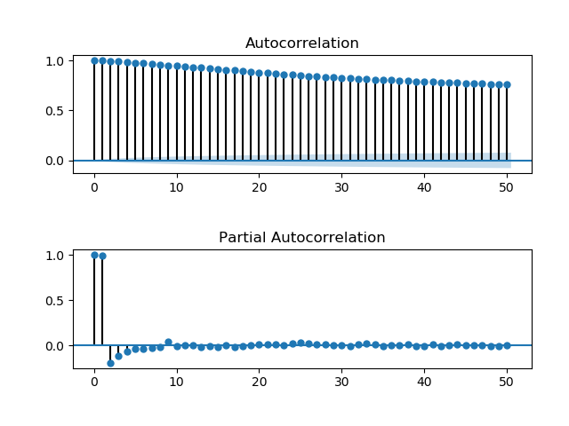
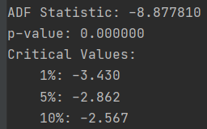
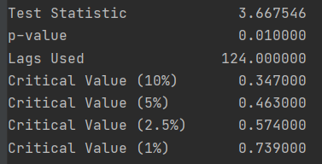
Stationarity
This is the ACF/PACF plots of raw data.
From ADF test, raw data is stationary
From KPSS test, raw data is non-stationary
ADF test results: KPSS test results:

Slide 7
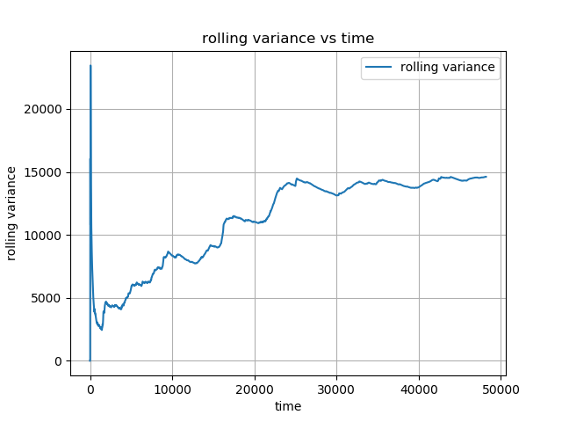
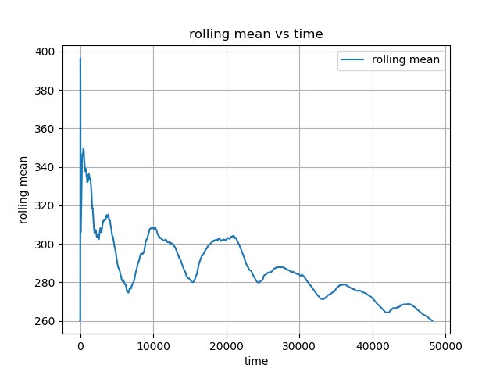
From below rolling mean and variance graphs we can say that the raw data is non-stationary.

Slide 8
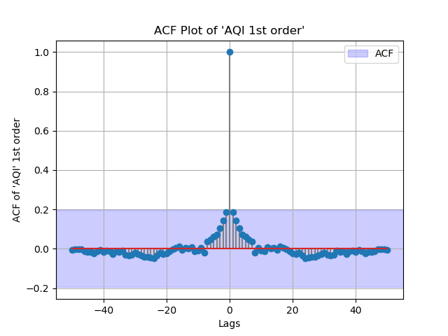
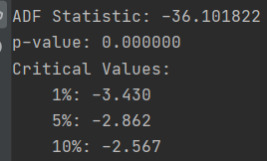
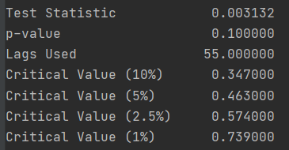
Stationary test on 1st order differenced data:
From ACF plot, the data looks stationary
From ADF test results, the data is stationary
From KPSS test results, the data is stationary
ADF test results: KPSS test results:

Slide 9
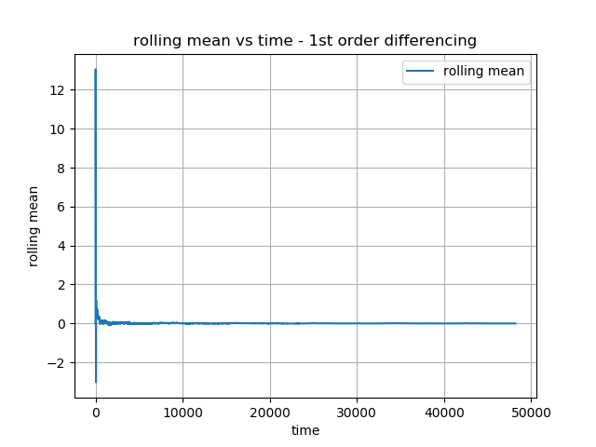
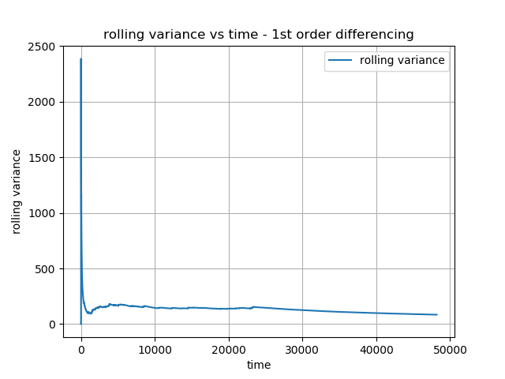
From below rolling mean and variance graphs we can say that the raw data is stationary as curve is constant.

Slide 10
Time Series Decomposition
We can observe that there is a very high trend in the raw data since the strength of the trend is very high at around ~ 0.99
There is low seasonality in the raw data since the strength of the seasonality is low at around ~0.269.

Slide 11
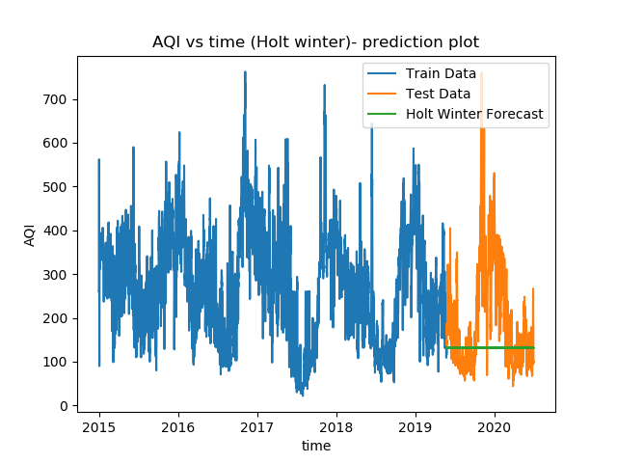
Holt-Winters method
We can observe that the Holt winter method did not give good predictions as it is not following the test results.

Slide 12
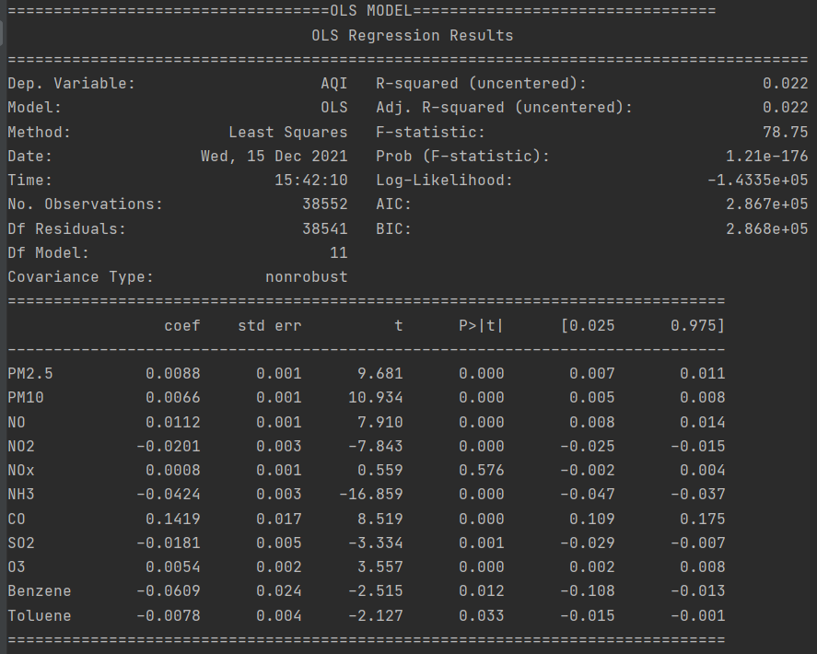
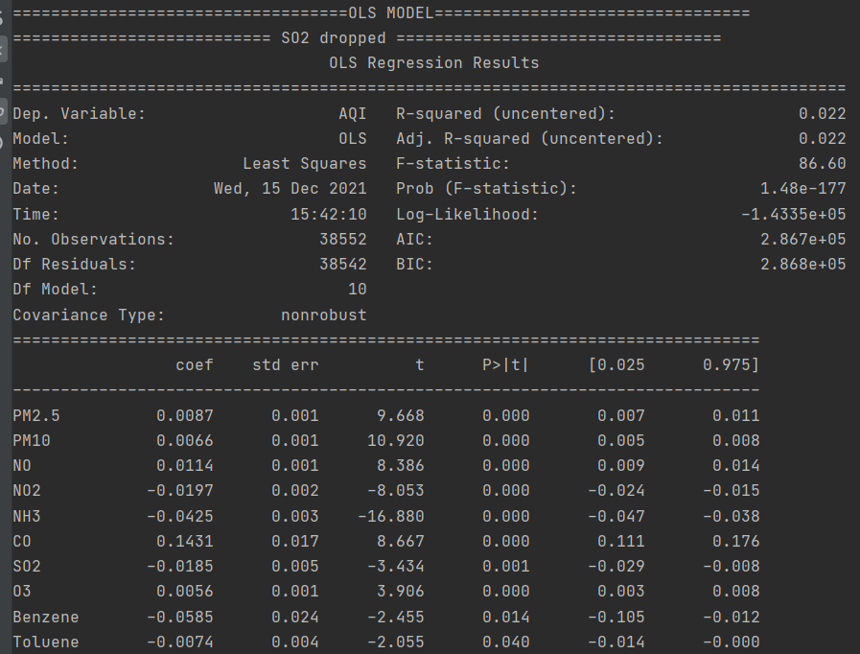
Feature Selection
On the right, we can observe that NOx has a p-value of 0.576, which is high so we can remove this variable and run the regression again.
Below is the final model of OLS regression

Slide 13
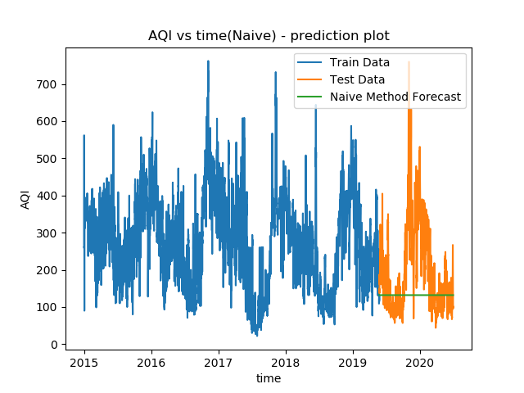
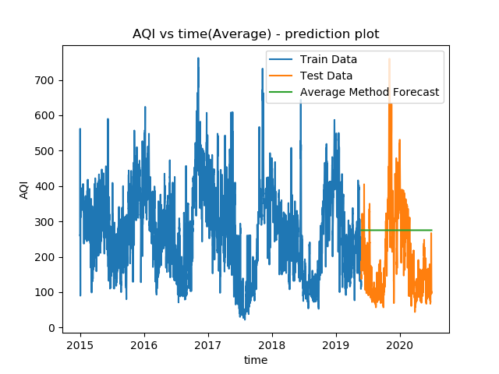


Base-Models:

Slide 14
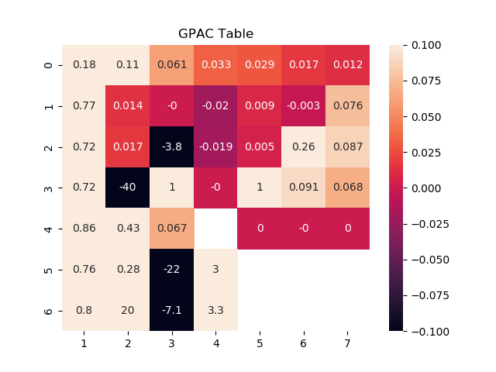
GPAC table
From the GPAC table, na=1, nb=1
2nd set, na=4, nb=4

Slide 15
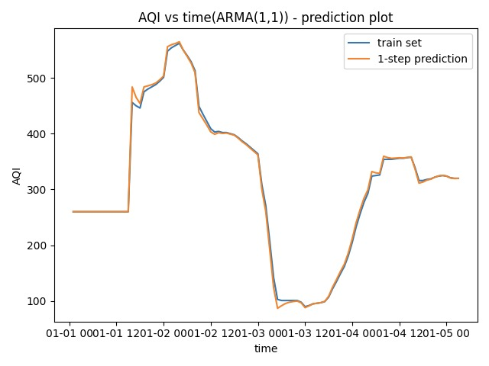
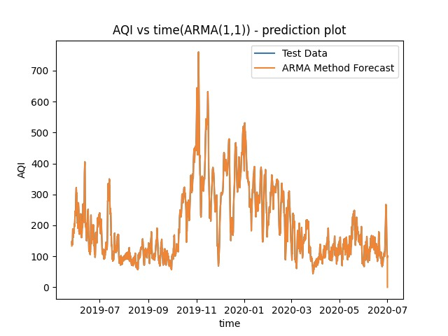
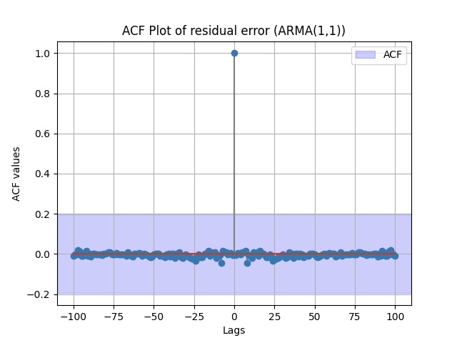
ARMA (1,1)
The AR Coefficient : a1 is:, 0.7171753492885212
The MA Coefficient : b1 is:, -0.5755961300211727
confidence intervals of estimated parameters: 0 1
ar.L1.AQI 0.690451 0.743900
ma.L1.AQI -0.606794 -0.544398
Chi Squared test results:
The residuals is white, chi squared value :2.835537718678142
variance of residual error : 97.59133695867716
variance of forecast error : 16.597283056833152

Slide 16
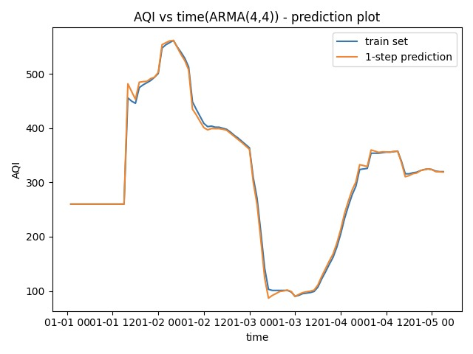

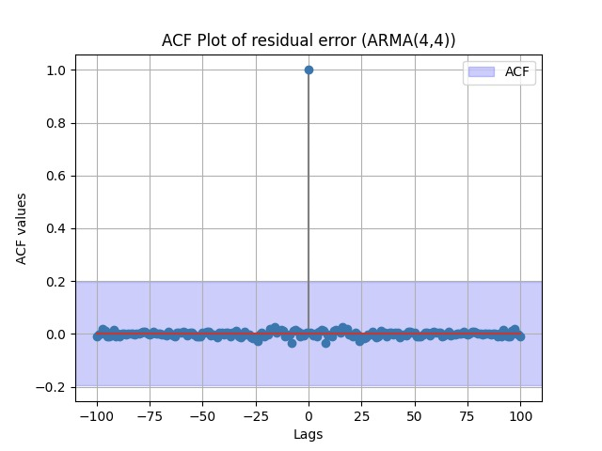
ARMA(4,4)
The AR Coefficient : a1 is:, 0.14351242375438633
The AR Coefficient : a2 is:, 1.1552483558701916
The AR Coefficient : a3 is:, 0.399960107818056
The AR Coefficient : a4 is:, -0.7200561297181469
The MA Coefficient : b1 is:, -0.01767431277600573
The MA Coefficient : b2 is:, -1.0691590548106715
The MA Coefficient : b3 is:, -0.4980845511577915
The MA Coefficient : b4 is:, 0.591488024446287
Chi Squared test results
The residuals is white, chi squared value :2.288682516508118
variance of residual error : 96.77649614930512
variance of forecast error : 16.592978261645367

Slide 17
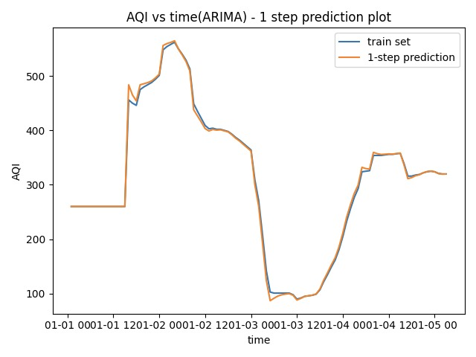
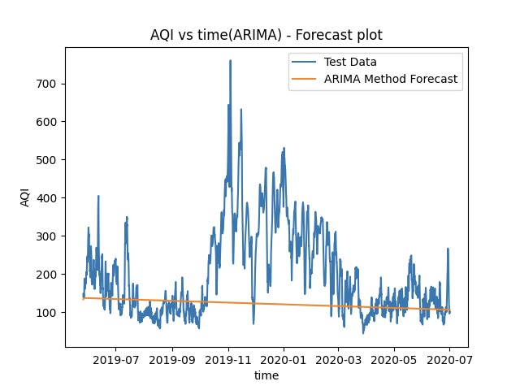

ARIMA(1,1,1)
The AR Coefficient : a1 is:, -0.003177624943659035
The MA Coefficient : b1 is:, 0.7171760560169066
Chi Squared test results
The residuals is white, chi squared value :2.8506147859063486
confidence intervals of estimated parameters: 0 1
const -0.151148 0.144793
ar.L1.D.AQI 0.690452 0.743900
ma.L1.D.AQI -0.606795 -0.544399
variance of residual error : 98.04075576373411
variance of forecast error : 13220.248652586179

Slide 18
Summary and conclusion
We found out that 1st order differenced data is stationary, the raw data is non-stationary
We built the ARMA (1,1), ARMA(4,4) and ARIMA (1,1,1) models and compared the results of the prediction and forecast and found out that the ARMA(4,4) model is the best model as it has the lowest variance of residual error and variance of forecast error.
We did not perform SARIMA model as we found from the time series decomposition that our dataset did not have much seasonality.

Slide 19
References:
https://www.kaggle.com/rohanrao/air-quality-data-in-india
https://plotly.com/
https://dash.plotly.com/dash-core-components
https://dash.plotly.com/dash-html-components
Class lecture videos and lecture material
Labs and assignment code

Slide 20
Thank you

